Slide 1
Explicit Vocabulary Development and Instruction
Natalie Montgomery
Reading Specialist
Just Read, Florida!
Randi Shiver
Reading Specialist
Just Read, Florida!
Notes:
1 minute (1/50)
Thank you for joining us to explore Explicit Vocabulary Development and Instruction!
(Facilitators introduce themselves.)
Today we will dive into vocabulary with a focus on:
The types of vocabulary;
Selecting vocabulary words for instruction;
B.E.S.T. English Language Arts (ELA) Standards vocabulary benchmarks; and
Explicit instructional routines for teaching vocabulary.

Slide 2
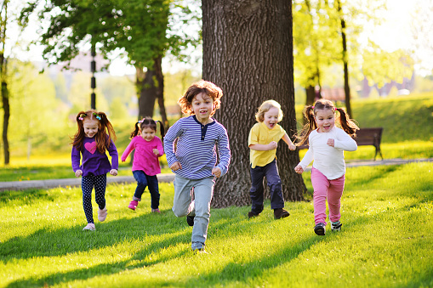
Why do we have noses that run and feet that smell?
English is a funny language!
Notes:
.5 minute (1.5/50)
Vocabulary refers to the words we must understand to communicate effectively. It is a fundamental component of the reading process that contributes greatly to a reader's comprehension.
Students learn the meanings of most words indirectly, through everyday experiences with oral and written language. Other words need to be taught directly through explicit instruction. The development of vocabulary skills is essential in empowering young learners to read, think, speak and write with confidence and clarity.
Source: https://www.readingrockets.org/helping/target/vocabulary

Slide 3
Four Types of Vocabulary
The words we need to understand what we read.
The words we use when we write.
Reading
Writing
The words we need to understand what we hear.
The words we use when we speak.
Listening
Speaking
Notes:
1.5 minutes (3/50)
Teaching vocabulary is complex. It is useful to begin with an understanding of the types of vocabulary words.
Researchers often refer to the four types of vocabulary:
Reading - the words we need to understand what we read
Writing - the words we use when we write
Listening - the words we need to understand what we hear
Speaking - the words we use when we speak

Slide 4
Subject/Content Words
ecosystem, environment, terrarium,
conjunction, decimal, genre
Three Tiers of Vocabulary Instruction
3
Subject/Content Words
Ecosystem, terrarium, acute, genre, conjunction
2
Academic Words
Example, cause, increase, defend, compare
1
Basic Words
In, out, house, dog, blue, flower
Notes:
1.5 minutes (4.5/50)
Isabel Beck’s Three Tier Model for choosing vocabulary can assist with determining which words are best suited for explicit instruction.
Tier 1 - Basic words that label common objects or concepts. These words are typically found in oral language. Tier 1 words are important to the text but can be dealt with quickly, with very little attention. Examples of Tier 1 words are: in, out, house, dog, blue, flower.
Tier 2 - Tier 2 words are the most important for instruction. These are academic words that are critical to comprehension. Tier 2 words have a high utility rate among literate language users and are used across content areas. Tier 2 also encompasses words with multiple meanings. Examples of Tier 2 words are: cause, increase, defend, compare.
Tier 3 – Tier 3 words are subject-specific words that label content. Tier 3 is comprised of low-frequency words that occur in specific domains. Examples of Tier 3 words are: ecosystem, terrarium, acute, genre, conjunction.
*Image courtesy of Pixabay.com.
Sources:
http://handyhandouts.com/viewHandout.aspx?hh_number=182&nfp_title=Three+Tiers+of+Vocabulary+and+Education
Florida’s B.E.S.T. Standards: English Language Arts, page 198

Slide 5
Three Tiers of Vocabulary Instruction
Tier 3
Is it a technical, subject specific, rare
or unique word?
Is it critical to comprehension?
Does it need a precise definition?
Does it have a connection to other words?
Is it a word that is useful across content areas?
Is it a conceptual word that cannot be demonstrated?
Is it a high frequency word that will be encountered often?
Is it a word with multiple meanings, dependent on context?
Tier 2
Is it an idiom?
Can I use a visual?
Is there a cognate?
Can I offer a quick, simple explanation?
Is it a word that the student knows in his home language?
Is it a word that will be learned incidentally through social interaction?
Tier 1
Notes:
2 minutes (6.5/50)
Keep in mind that, despite lists that identify first-grade words or fifth-grade words, there is no formula for selecting age-appropriate vocabulary words. The questions on this slide serve to assist in determining within which tier a vocabulary word fits.
Tier 1: Remember that these words do not have multiple meanings and they rarely require formal instruction. Read questions on slide.
Tier 2: These are the words that should be selected for explicit instruction. Read questions on slide.
Tier 3: These are low frequency, domain specific words. Read questions on slide.

Slide 6
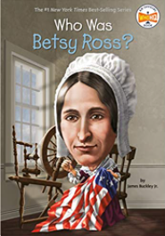
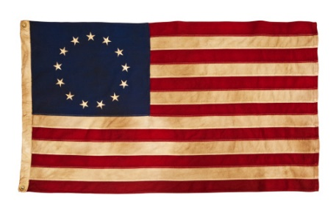
Sorting Vocabulary Words
By 1793, Betsy and John had a fine family, a good home, and steady work. But in the summer of that year, a tragic epidemic spread throughout Philadelphia. Yellow fever struck, and thousands of people died from the disease. Betsy’s parents died early in the epidemic. Betsy’s sister Deborah died, too. Her sister Mary died soon after, also possibly from the fever.
The yellow fever epidemic was over by early 1794. That year, John found another job. He went to work for the new United States government as a customs inspector. His job was to check the imported items
brought to Philadelphia on ships.
Who Was Betsy Ross?
by James Buckley Jr.
3rd grade B.E.S.T. text list
Notes:
1.5 minutes (8/50)
We are going to take a few minutes to apply what we have learned to choose vocabulary words for explicit instruction. This is an excerpt from Who Was Betsy Ross? by James Buckley Jr, which is found within the third grade B.E.S.T. ELA text list.
Read the passage on the slide.

Slide 7
Sorting Vocabulary Words
By 1793, Betsy and John had a fine family, a good home, and steady work. But in the summer of that year, a tragic epidemic spread throughout Philadelphia. Yellow fever struck, and thousands of people died from the disease. Betsy’s parents died early in the epidemic. Betsy’s sister Deborah died, too. Her sister Mary died soon after, also possibly from the fever.
The yellow fever epidemic was over by early 1794. That year, John found another job. He went to work for the new United States government as a customs inspector. His job was to check the imported items
brought to Philadelphia on ships.
Who Was Betsy Ross?
by James Buckley Jr.
3rd grade B.E.S.T. text list
Notes:
3 minutes (11/50)
Handout #1 Note Catcher
The identified vocabulary words are delineated in red on this slide. Use the note catcher to categorize these vocabulary words into the appropriate Tier.
Provide time for participants to categorize the words and record their responses on Handout #1 Note Catcher before reviewing:
T1: Basic words - home, sister, job, ships
T2: Academic words - summer, government, disease
T3: Domain specific words - epidemic, customs, Philadelphia
Beyond the words that play major roles, choices about what specific set of words to teach are quite arbitrary and should be determined by students’ needs. Teachers should feel free to use their best judgment in selecting vocabulary words for explicit instruction.

Slide 8
Explicit Vocabulary Instruction
Explicit instruction is intentional teaching with a clear and direct presentation of new information.
It does not require student inferencing during the introduction of new or previously taught content, concepts or skills.
1
2
3
4
Introduces the new or previously taught content, concept or skill clearly and directly.
Models or demonstrates use of the new or previously taught content, concept or skill.
Provides clear visual and/or auditory examples (and non-examples when needed) to illustrate specific application of content, concept or skill.
Provides learners frequent opportunities for guided and independent practice of new or previously taught content concept or skill.
Notes:
1 minute (12/50)
Explicit instruction is intentional teaching with a clear and direct presentation of new information.
It does not require student inferencing during the introduction of new or previously taught content, concepts or skills.
Explicit instruction contributes to the learner’s:
Clear understanding of newly introduced or previously taught content, concepts and skills;
Positive engagement in relating to the new learning; and
Strong early literacy progress.
The gradual release model is one example of explicit instruction. Within this model:
New or previously taught content is introduced clearly and directly;
The teacher models or demonstrates the use of the new or previously taught content, concept or skill;
Visual and/or auditory examples and non-examples are provided; and
Learners are given frequent opportunities for guided and independent practice.

Slide 9
B.E.S.T Vocabulary Benchmarks
1) Academic Vocabulary (V.1.1)
2) Morphology (V.1.2)
3) Context and Connotation (V.1.3)
Subject Code
Strand
Benchmark
ELA.3.V.1.1
Grade level
Standard
Notes:
.5 minute (12.5/50)
Handout #2 B.E.S.T. Explicit Vocabulary Instruction Benchmarks and Appendices
Florida’s B.E.S.T. ELA vocabulary strand is composed of one standard: Finding Meaning.
The benchmarks within the standard focus on:
Academic Vocabulary;
Morphology; and
Context and Connotation comprise the three.
The image on this slide highlights the coding scheme for Florida’s B.E.S.T. ELA Standards.

Slide 10
B.E.S.T. Clarifications
Remember to reference the benchmark clarifications when planning for vocabulary instruction.
ELA.3.V.1.1 Use grade-level academic vocabulary appropriately in speaking and writing.
Benchmark Clarification: Grade-level academic vocabulary consists of words that are likely to appear across subject areas for the current grade level and beyond, vital to comprehension, critical for academic discussions and writing and usually require explicit instruction.
ELA.3.V.1.2 Identify and apply knowledge of common Greek and Latin roots, base words, and affixes to determine the meaning of unfamiliar words in grade-level content.
Benchmark Clarification: See common Greek and Latin Roots 3-5 and Affixes.
Notes:
1.5 minutes (14/50)
Handout #2 B.E.S.T. Explicit Vocabulary Instruction Benchmarks and Appendices
Remember to reference the benchmark clarifications when planning for vocabulary instruction.
ELA.3.V.1.1 – Referring back to the coding scheme, you can see that this first benchmark is:
ELA
Grade 3
Vocabulary strand
Standard 1 - Finding Meaning is the only standard
Benchmark 1 - Academic Vocabulary
The benchmark requires students to “Use grade-level academic vocabulary appropriately in speaking and writing. The clarification expands upon the benchmark to define Grade-level academic vocabulary as words that are likely to appear across subject areas for the current grade level and beyond, vital to comprehension, critical for academic discussions and writing and usually require explicit instruction.”
As a second example, we will look at the clarification for ELA.3.V.1.2. You can see that this is Grade 3; Vocabulary strand; Standard 1; Benchmark 2, which is Morphology. (Read benchmark) The clarification draws your attention to the list of common Greek and Latin roots and affixes that is provided within Appendix D.
Provide Handout #2 B.E.S.T. Explicit Vocabulary Instruction Benchmarks and Appendices and call attention to the benchmark clarifications.

Slide 11
B.E.S.T. Appendix D
1) Selecting Academic Vocabulary for Direct Instruction
1) Base Words
2) Greek and Latin Roots
3) Common Prefixes
4) Common Suffixes
5) Foreign Words and Phrases
1) Context Clues
Academic Vocabulary
(V.1.1)
Morphology (V.1.2)
Context and Connotation (V.1.3)
Notes:
3 minutes (17/50)
Handout #2 B.E.S.T. Explicit Vocabulary Instruction Benchmarks and Appendices
Appendix D of Florida’s B.E.S.T. ELA Standards provides valuable resources pertaining to vocabulary instruction. You will find:
A guide for selecting academic vocabulary;
Resources that support morphology including:
Lists of frequently occurring base words for 1st and 2nd grade
Sample lists of Greek and Latin roots for 3rd-5th grade and for 6th-8th grade
Charts of common prefixes and suffixes; including the part of speech, a definition/meaning and examples; and
3. A guide for context clues and word relationships.
Provide time for participants to review the appendix pages within Handout #2 B.E.S.T. Explicit Vocabulary Instruction Benchmarks and Appendices.

Slide 12
Academic Vocabulary
“By guiding students to develop their academic language skills, teachers can mitigate some of the challenges that students encounter when learning to comprehend text.”
https://ies.ed.gov/ncee/wwc/Docs/PracticeGuide/wwc_foundationalreading_040717.pdf
Notes:
.5 minute (17.5/50)
Review quote on slide from IES Practice Guide.

Slide 13
Academic Vocabulary Benchmarks
ELA.5.V.1.1 Use grade-level academic vocabulary appropriately in speaking and writing.
ELA.4.V.1.1 Use grade-level academic vocabulary appropriately in speaking and writing.
ELA.3.V.1.1 Use grade-level academic vocabulary appropriately in speaking and writing.
ELA.2.V.1.1 Use grade-level academic vocabulary appropriately in speaking and writing.
ELA.1.V.1.1 Use grade-level academic vocabulary appropriately in speaking and writing.
ELA.K.V.1.1 Use grade-level academic vocabulary appropriately in speaking and writing.
Notes:
1 minute (18.5/50)
Handout #1 Note Catcher
This slide highlights the academic vocabulary benchmarks for grades K-5. Please take a minute to highlight the benchmark for your grade. (Provide time for participants to highlight their grade-level benchmark.)
Ask participants to look for differences in the grades – there are no differences! The benchmark is the same for grades K-5: Use grade-level academic vocabulary appropriately in speaking and writing.

Slide 14
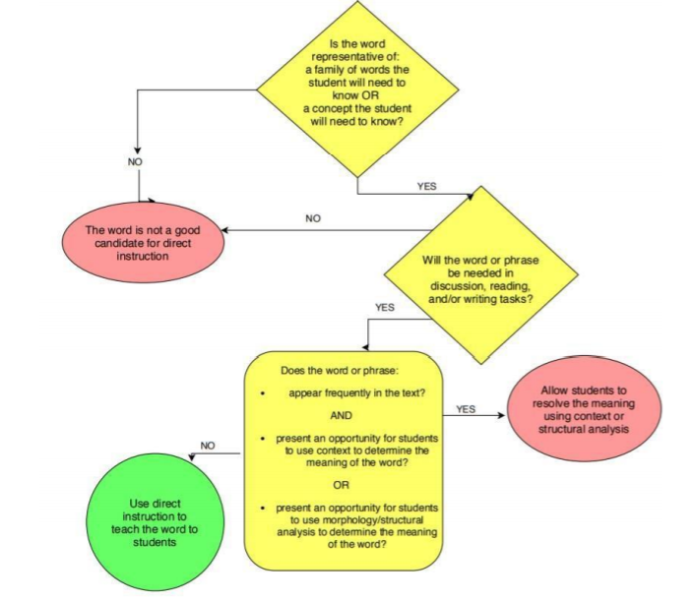
Academic Vocabulary Selection
Academic Vocabulary Selection Decision Map
Notes:
1 minute (19.5/50)
An important element of academic vocabulary instruction is determining which words require direct instruction and which words students can determine for themselves using context clues or morphology as appropriate. Appendix D (page 198) of the B.E.S.T ELA Standards provides a decision map for selecting words for direct instruction.
Words that are selected for explicit vocabulary instruction should:
Be representative of a family of words or a concept that the student will need to know;
Be needed in discussion, reading or writing tasks;
Appear frequently in text and present an opportunity for students to use context clues to determine the meaning; or
Present an opportunity for the students to utilize morphology/structural analysis to determine meaning.

Slide 15
Academic Vocabulary Routine
Have students say the word.
Provide a student-friendly definition and apply the definition to the context of the text.
3. Have students discuss what is known about the word.
4. Explicitly clarify and reinforce the definitions using examples and non-examples.
Epidemic
An outbreak of a disease that quickly infects a large number of people
It sounds like pandemic.
I have heard the word on the news.
Example: seasonal flu
Non-examples: headache, cancer
Notes:
1.5 minute (21/50)
Academic vocabulary should be taught in-depth, using multiple modalities (writing, speaking, listening). We are going to take a look at a routine for teaching academic vocabulary.
1. Have students say the word – Epidemic
2. Provide a student-friendly definition and apply the definition to the context of the text.
Complete definition – A widespread occurrence of an infectious disease in a community at a particular time
Student friendly definition – An outbreak of a disease that quickly infects a large number of people
Context within the passage – In the summer of that year, a tragic epidemic spread throughout Philadelphia.
3. Have students discuss what is known about the word. – It sounds like pandemic. I have heard it on the news.
4. Explicitly clarify and reinforce the definitions using examples and non-examples. It is important include non-examples; these can be generated by choosing and antonym of the target word.
Examples – seasonal flu; Non-examples – headache, cancer
Sources:
https://www.google.com/search?q=definition+of+epidemic&rlz=1C1GCEB_enUS979US979&oq=definition+of+epidemic&aqs=chrome..69i57j0i512l9.6584j1j7&sourceid=chrome&ie=UTF-8https://ies.ed.gov/ncee/wwc/Docs/PracticeGuide/english_learners_pg_040114.pdf#page=20
https://www.google.com/search?q=kid+friendly+definition+of+epidemic&rlz=1C1GCEB_enUS979US979&oq=kid+friendly+definition+of+epidemic&aqs=chrome..69i57j0i22i30l2j0i390l4.8838j0j7&sourceid=chrome&ie=UTF-8

Slide 16
Academic Vocabulary Routine
5. Engage in deep-processing activities by asking questions, using graphic
organizers, or having students act out the word.
Deep Processing Words
Compare | Decide
Categorize | Justify
Design | Create
Contrast | Verify
Rate | Imagine
Recommend | Predict
Definition
Target Word
Synonyms
Antonyms
Examples
Non-examples
6. Scaffold learning and provide opportunities to create powerful sentences with the new word.
Notes:
1.5 minute (22.5/50)
The fifth step in the academic vocabulary routine is to:
Engage in deep-processing activities by asking questions, using graphic organizers or having students act out the word. This deep processing provides a more meaningful analysis of the word that elicits better recall. An example would be “Predict what would happen if an epidemic were to spread through Tallahassee.” or “Write a recommendation for stopping the spread of an epidemic.”
Graphic organizers are also useful in supporting students as they begin to solidify their knowledge. When possible, reinforce the meaning of the word by using concrete representations such as pictures, gestures and actions. For example, students could act out a scene depicting the spread of an epidemic or a teacher could show a photograph depicting an epidemic.
6. Scaffold learning and provide opportunities to create powerful sentences with the new word.
The epidemic swept through the state, devastating its citizens with sickness.
The government is actively preparing for a global flu epidemic.

Slide 17
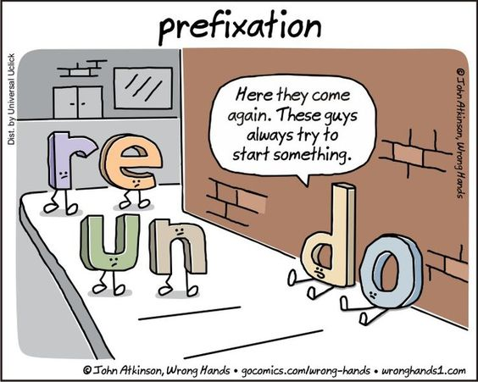
Morphology
https://creativecommons.org/
Notes:
.5 minute (23/50)
Morphology is the study of word structure and its meaningful parts.
When we use morphology, we look inside of a word to figure out its meaning.
This section gives content knowledge on morphology and provides explicit instructional routines which support the B.E.S.T. vocabulary benchmarks across grades K-5.

Slide 18
Morphology
ELA.5.V.1.2 Apply knowledge of Greek and Latin roots and affixes, recognizing the connection between affixes and parts of speech, to determine the meaning of unfamiliar words in grade-level content.
ELA.4.V.1.2 Apply knowledge of common Greek and Latin roots, base words, and affixes to determine the meaning of unfamiliar words in grade-level content.
ELA.3.V.1.2 Identify and apply knowledge of common Greek and Latin roots, base words, and affixes to determine the meaning of unfamiliar words in grade-level content.
ELA.2.V.1.2 Identify and use base words and affixes to determine the meaning of unfamiliar words in grade-level content.
ELA.1.V.1.2 Identify and use frequently occurring base words and their common inflections in grade-level content. ELA.K.V.1.2 Ask and answer questions about unfamiliar words in grade-level content.
ELA.K.V.1.2 Ask and answer questions about unfamiliar word in grade-level content.
Notes:
1 minute (24/50)
Handout #1 Note Catcher
Take a moment look over the morphology benchmarks for the vocabulary strand. After identifying the benchmark specific to your grade level, view the benchmarks above and below it. (Fifth grade will want to explore sixth grade benchmarks.)
Then take a moment to view the morphology benchmarks starting with kindergarten at the bottom, and work your way up to fifth grade to see the progression of learning.

Slide 19
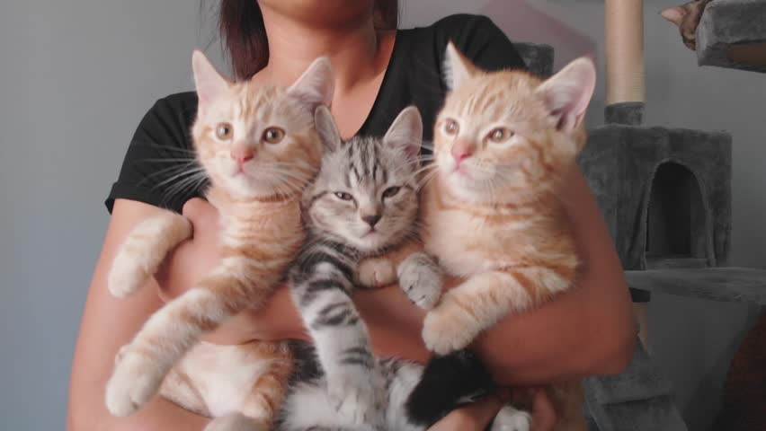
Morphology
Morpheme: smallest meaningful unit in a language
How many morphemes are in the word cats?
cats
feline
more than one
more than one feline
https://creativecommons.org/
Notes:
1 minute (25/50)
To understand morphology, one must first understand what a morpheme is. A morpheme is the smallest meaningful unit in a language.
How many morphemes, or small meaningful units are in the word cats? (Give wait time. Ask participants to show the answer with their fingers.)
There are two morphemes in the word cats.
Show animation and read information to participants as it appears on the screen.

Slide 20
Morphology
Morphological Awareness: the recognition, understanding and use of word parts that carry significance in meaning
Test your Morphological Awareness.
How many morphemes are in each word below?
unkind
unkind
not friendly
agreeable
agreeable
having the skill of deciding something together
mislead
mislead
wrongly guiding/guided/guide
painfulness
painfulness
condition full of discomfort
transport
transport
carry across
Charles was unkind to mislead the group as they worked together to transport the supplies. If he would just be agreeable this time, the painfulness of carrying the heavy rocks would not be so bad.
Notes:
2 minutes (27/50)
Morphology starts with awareness. Recognizing, understanding and using word parts that carry significance in meaning develops into morphological knowledge, which can be applied to reading, writing and comprehending unfamiliar words.
The next activity will test your morphological awareness, then show how you can apply your knowledge of morphemes to determine the meaning of unfamiliar words. This activity will be helpful to use with students when explaining and discussing morphemes.
Have participants analyze each word to determine how many morphemes it has, using their fingers to show their thinking. After each word, discuss the meaning of the morphemes and read the definition. (This slide is animated.)

Slide 21
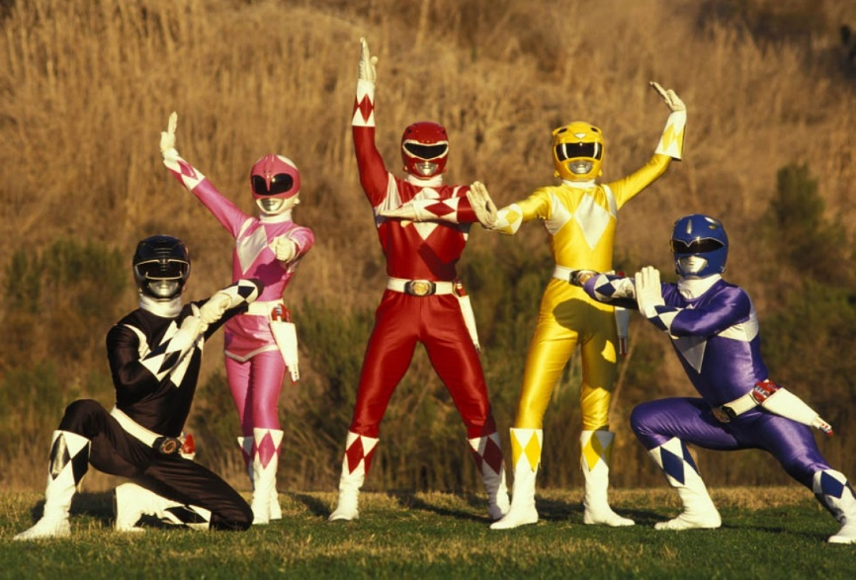
Morphology
The Power of Morphology
Orthographical Knowledge
(phonics)
Morphological Awareness
Phonological Awareness
(phonemic)
https://creativecommons.org/
Notes:
1 minute (28/50)
Morphology is powerful, but often overlooked in the learning process.
Morphology is not just reserved for vocabulary in terms of determining the meaning of unfamiliar words. It is much more powerful than that when students are aware of morphemes in word reading.
Explicit instruction that integrates morphological awareness with orthographical knowledge (or phonics), and phonological awareness provides the greatest impact. Students who learn how to attach meaning to parts of words will be empowered to be better readers and spellers.
Morphology develops in tandem with phonemic awareness and phonics, so K-2 teachers should be incorporating morphology instruction into daily learning. Intermediate teachers in grades 3-5 will build on students’ morphology knowledge to deepen their knowledge of word parts and apply it to reading and writing.

Slide 22
Morphology
Morphology Matters
Morphology (meaning) trumps phonology (pronunciation) when it comes to understanding meaning.
twin
two
to
too
between
twist
twice
twelve
twine
Twix
twenty
https://creativecommons.org/
Notes:
1.5 minutes (29.5/50)
Morphology (meaning) trumps phonology (pronunciation) when it comes to understanding meaning.
A great example is the word two. While students will understand its meaning, its pronunciation and spelling may be difficult when differentiating it from to and too. The orthography, or spelling of the word two is not reflected in its pronunciation.
As an example we will use the word two. The best way to learn this word is morphologically, not phonologically, because if you sound out two, the only letter that is behaving itself is the letter t. The w is not recognizable and the o is not making the short, long or schwa sound. By connecting the word two to other relatable words derived from the same common root, the orthography (phonics) is reflected in the pronunciation.
Show examples that are animated and discuss them with participants.
In these example words, the letter w is reflected in in its pronunciation – twin, twice, twelve. Even though the letter w isn’t reflected in the pronunciation of the word two, readers can make a morphological connection to the word to determine the spelling and meaning.

Slide 23
Morphology Benchmark Progression K - 1st
Kindergarten | First
Ask and answer questions about unfamiliar words in grade-level content. | Identify and use frequently occurring base words and their common inflections in grade-level content.
 | helping opening jumping walking playing
“Oh, I’m sure she would hold me,” sobbed Choco. “Like this?” asked Mrs. Bear. And she held him very tight.
The teacher also asks students questions about words which may be unfamiliar to help develop their vocabulary.
https://creativecommons.org/
Notes:
1 minute (30.5/50)
The morphology benchmark for kindergarten requires students to ask and answer questions about unfamiliar words in grade-level content.
When students ask questions about unfamiliar words they read, they begin to use metacognition, or become aware of their thought process. This helps students learn to read critically and self-monitor their comprehension of text.
When the teacher asks students questions about an unfamiliar word, they begin to lead students into intentional conversations that build critical-thinking skills, which develop vocabulary and comprehension skills.
Following an instructional routine will provide explicit instruction for this morphology benchmark.
The teacher clearly defines the word.
The teacher demonstrates/models how to use the word.
The teacher shows examples/non-examples and visuals.
The teacher provides opportunities for guided and independent practice.
The morphology benchmark for first grade focuses on students identifying and using frequently occurring base words and their common inflections in grade-level content.
Students are now starting to analyze word parts and look inside words to understand their meaning!
Appendix D has a list of frequently occurring base words.
Following an instructional routine will provide explicit instruction for this morphology benchmark.
The teacher clearly introduces the base word and common inflection.
The teacher demonstrates/models how to identify and use the base word and common inflection.
The teacher gives visual and auditory examples/non-examples.
The teacher provides opportunities for guided and independent practice.

Slide 24
Morphology Benchmark Progression 2nd - 3rd
Second | Third
Identify and use base words and affixes to determine the meaning of unfamiliar words in grade-level content. | Identify and apply knowledge of common Greek and Latin roots, base words, and affixes to determine the meaning of unfamiliar words in grade-level content.
I felt helpless and had nowhere to go.
The root word is form and it means “shape.”
helpless
formation format
transform deform
assistance
without
transform: change shape
formation: shaping
without assistance
Notes:
1 minute (31.5/50)
The morphology benchmark for second grade focuses on students identifying and using base words and affixes to determine the meaning of unfamiliar words.
The clarifications for this benchmark guide teachers to a sample list of base words for second grade.
Here is an example of an instructional routine which will provide explicit instruction for this morphology benchmark.
The teacher clearly introduces the base word and affix.
The teacher demonstrates/models how to identify and use the base word and affix to determine the meaning of unfamiliar words.
The teacher gives visual and auditory examples/non-examples.
The teacher provides opportunities for guided and independent practice.
The morphology benchmark for third grade introduces Greek and Latin roots to base words and affixes to determine the meaning of unfamiliar words. Students are now required to apply their knowledge of morphemes, not just identify and use morphemes.
The clarifications for this benchmark guide teachers to Appendix D, where a sample list of Greek and Latin Roots and affixes are located.
Here is an example of an instructional routine which will provide explicit instruction for this morphology benchmark.
The teacher clearly introduces the Greek and/or Latin root, base word and affix.
The teacher demonstrates/models how to identify and use the Greek and/or Latin root, base word and affix to determine the meaning of unfamiliar words.
The teacher gives visual and auditory examples/non-examples.
The teacher provides opportunities for guided and independent practice.

Slide 25
Morphology Benchmark Progression 4th - 5th
Fourth | Fifth
Apply knowledge of common Greek and Latin roots, base words and affixes to determine the meaning of unfamiliar words in grade-level content. | Apply knowledge of Greek and Latin roots and affixes, recognizing the connection between affixes and parts of speech, to determine the meaning of unfamiliar words in grade-level content.
We could not afford to pay our phone bill, so our phone service was disconnected.
The suffix –ful means “full of” and its part of speech is an adjective.
disconnected
sorrowful – full of sorrow
resourceful – full of resources
distasteful – full of distaste
uneventful – full of no events
insightful – full of insight
not
join together
action/
past
not joined together any longer
Notes:
1 minute (32.5/50)
The morphology benchmark for fourth grade continues to focus on students applying knowledge of common Greek and Latin roots, base words and affixes to determine the meaning of unfamiliar words.
Here is an example of an instructional routine which will provide explicit instruction for this morphology benchmark.
The teacher clearly introduces the skill of applying knowledge of a Greek or Latin root, base word and affix to determine the meaning of an unfamiliar word.
The teacher demonstrates/models how to apply knowledge of a Greek or Latin root, base word and affix to determine the meaning of an unfamiliar word.
The teacher gives visual and auditory examples/non-examples.
The teacher provides opportunities for guided and independent practice.
Appendix D of the B.E.S.T. Standards will support the fourth and fifth grade benchmarks with a list of Greek and Latin roots and affixes.
The morphology benchmark for fifth grade extends students’ knowledge and application of Greek and Latin roots and affixes to recognizing their connection between affixes and parts of speech to determine the meaning of unfamiliar words.
Here is an example of an instructional routine which will provide explicit instruction for this morphology benchmark.
The teacher clearly introduces the skill of applying a Greek or Latin root, base word and affix and makes a connection to the part of speech to determine the meaning of an unfamiliar word.
The teacher demonstrates/models how to apply knowledge of a Greek or Latin root, base word and affix and its part of speech to determine the meaning of an unfamiliar word.
The teacher gives visual and auditory examples/non-examples.
The teacher provides opportunities for guided and independent practice.
Through the progression of the morphology benchmarks, students are learning to look within words to analyze their parts to determine their meaning. This is a skill that students will depend on throughout their lifetime of learning!

Slide 26
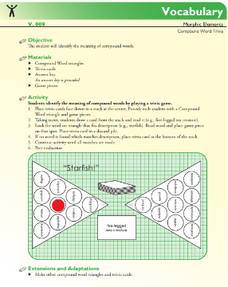
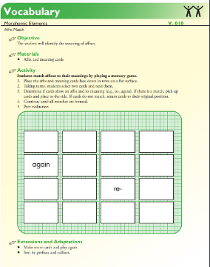
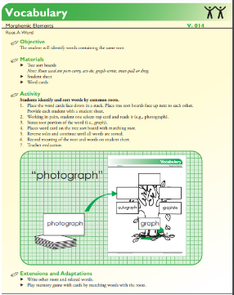
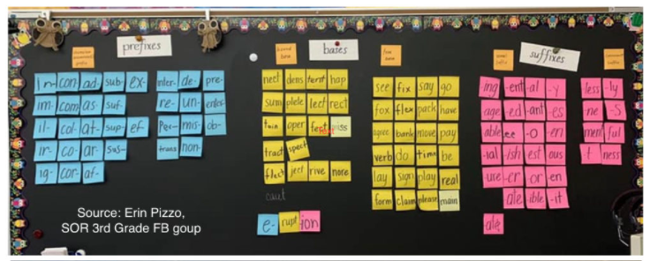
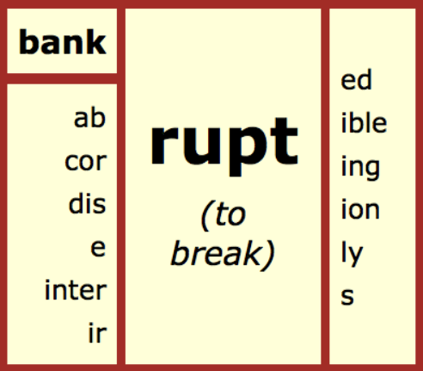
Morphology
Florida Center For Reading Research (FCRR)
Student Center Activities
Morphology Wall
Morphology Matrix
https://creativecommons.org/
Notes:
.5 minute (33/50)
Florida Center for Reading Research (FCRR) provides many morphology Student Center Activities.
Make morphology part of your daily learning environment with an interactive morphology wall.
A Morphology Matrix is a great way for students to explore morphemes and build their knowledge on examining word parts.
There are many resources available online to assist you in implementing morphology word walls and morphology matrices with students.

Slide 27
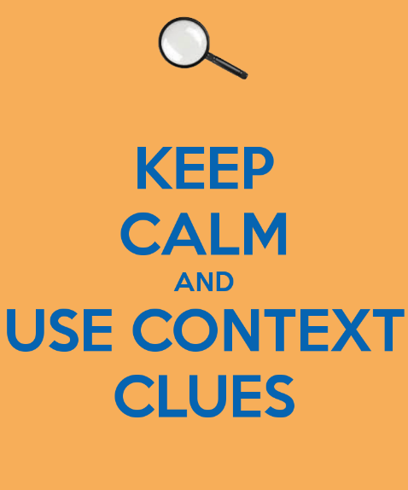
Context and Connotation
https://creativecommons.org/
Notes:
.5 minute (33.5/50)
Context clues are hints used by the author to support readers in connecting prior knowledge to interpret the vocabulary and message of the text.
Connotation is defined as a feeling or idea a word has in addition to its literal meaning.
Unlike morphology, which takes readers inside words, context clues take readers outside of words to find ways to clarify the meaning of unfamiliar words.
The combination of using morphology and context clues – looking inside and outside of words, will enhance vocabulary and comprehension.
This section gives content knowledge on context clues and connotation and provides explicit instructional routines, which support the B.E.S.T. vocabulary benchmarks across grades K-5.

Slide 28
Context and Connotation
ELA.5.V.1.3 Use context clues, figurative language, word relationships, reference materials and/or background knowledge to determine the meaning of multiple-meaning and unfamiliar words and phrases, appropriate to grade level.
ELA.4.V.1.3 Use context clues, figurative language, word relationships, reference materials, and/or background knowledge to determine the meaning of multiple-meaning and unfamiliar words and phrases, appropriate to grade level.
ELA.3.V.1.3 Use context clues, figurative language, word relationships, reference materials and/or background knowledge to determine the meaning of multiple-meaning and unfamiliar words and phrases, appropriate to grade level.
ELA.2.V.1.3 Identify and use context clues, word relationships, reference materials and/or background knowledge to determine the meaning of unfamiliar words.
ELA.1.V.1.3 Identify and use picture clues, context clues, word relationships, reference materials and/or background knowledge to determine the meaning of unfamiliar words.
ELA.K.V.1.3 Identify and sort common words into basic categories, relating vocabulary to background knowledge.
Notes:
1 minute (34.5/50)
Handout #1 Note Catcher
Take a moment look over the context and connotation benchmarks for the vocabulary strand. After identifying the benchmark specific to your grade level, view the benchmarks above and below it. (Fifth grade will want to explore sixth grade benchmarks.)
Then take a moment to view the context and connotation benchmarks starting with kindergarten at the bottom, and work your way up to fifth grade to see the progression of learning.

Slide 29
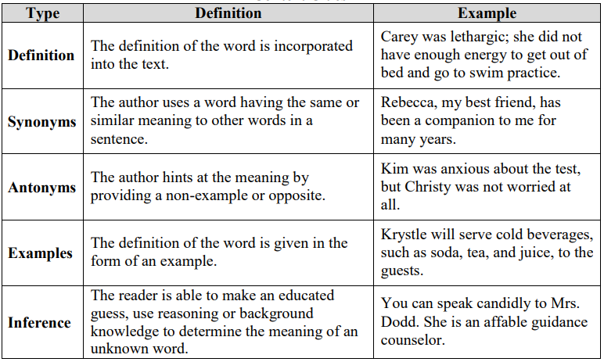
Context and Connotation
Five Types of Context Clues
https://creativecommons.org/
Notes:
.75 minute (35.25/50)
In Appendix D on page 205, you will find the information on five types of context clues which help develop vocabulary knowledge and support reading comprehension.
Explicitly teaching the five types of context clues to students will lead to the awareness of clues or hints that can be found in surrounding text.

Slide 30
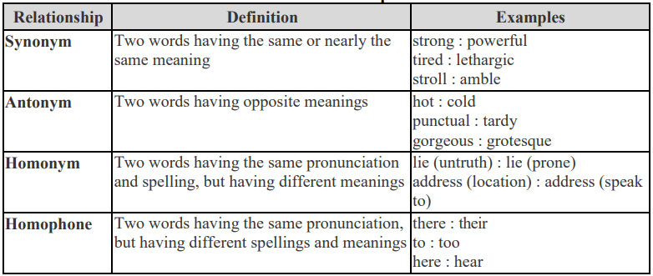
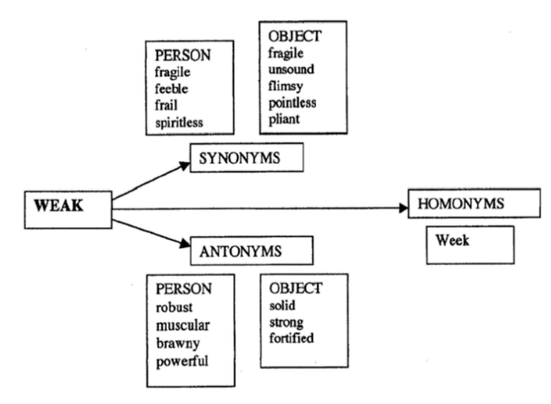
Context and Connotation
Word Relationships
In less than a week, he was feeling as weak and fragile as a newborn kitten, but would not give up on his powerful journey to discover new land.
https://creativecommons.org/
Notes:
.75 minute (36/50)
It is important for students to understand that words in any language exist individually, but can also be closely related to one another.
Although understanding word relationships is an abstract skill, explicitly teaching students to identify the relationship between words will increase their vocabulary and support their understanding of the context in which the words are used.
Take a minute to read the sentence on the slide.
The sentence on this slide contains homonyms (week and weak) and synonyms (weak and fragile) and an analogy (as weak and fragile as a newborn kitten) and an antonym (weak and powerful).
If the unknown words was “fragile”, using the word relationships in the sentence and the context will help determine the meaning of the word.
This is an example of looking outside of the word to determine its meaning.
You can find this chart of word relationships in your handouts as well as in Appendix D, page 205 in the B.E.S.T. ELA Standards.

Slide 31
Context and Connotation
Reference Materials
Dictionary
Glossary
Atlas
Internet
https://creativecommons.org/
Notes:
1 minute (37/50)
Instruction in using reference materials aids students in determining the meaning of unfamiliar words, especially as they become independent readers.
Teaching students to use reference materials to explore the meaning or confirm their understanding of a word can support instruction in context and connotation.
Digital texts provide built-in reference tools students can use to aid in their understanding of unfamiliar words they encounter as they read.
Students should be encouraged to use reference materials as a tool to support vocabulary.

Slide 32
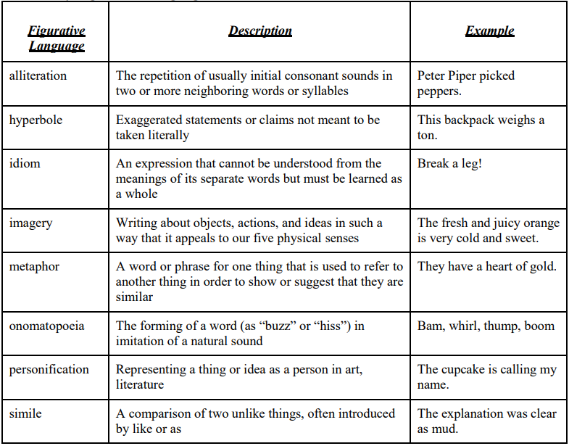
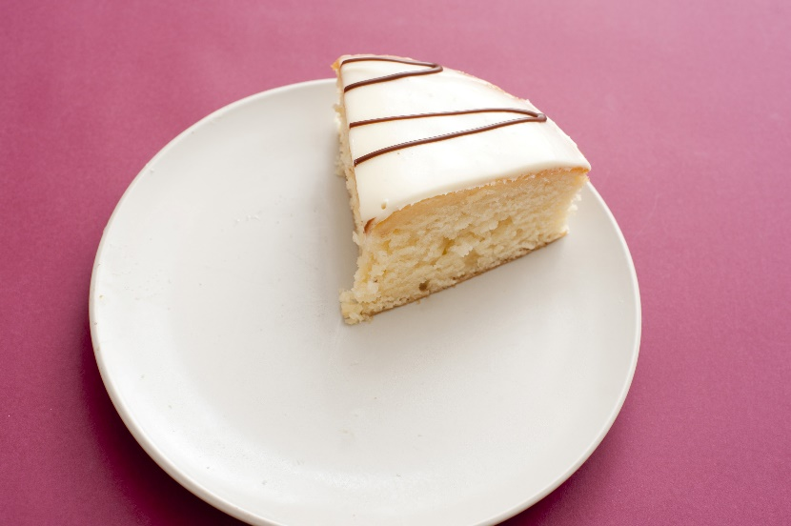
Context and Connotation
Figurative Language
Vocabulary makes comprehension a piece of cake!
https://creativecommons.org/
Notes:
.5 minute (37.5/50)
Knowledge of figurative language is also helpful for students when determining the meaning of unknown words, as it can sometimes be abstract.
This is an example of how vocabulary and comprehension are connected.
Many students (and adults like myself) love figurative language and enjoy the way it brings words and phrases to life!
The figurative language chart shown here can be found in Appendix A on page 175.

Slide 33
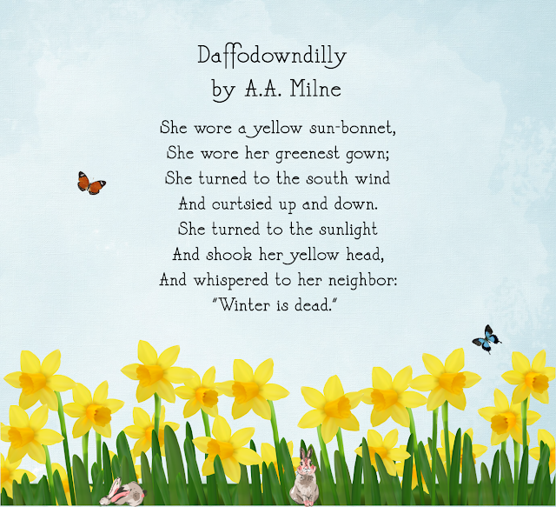
Context and Connotation Benchmark Progression K - 1st
Kindergarten | First
Identify and sort common words into basic categories, relating vocabulary to background knowledge. | Identify and use picture clues, context clues, word relationships, reference materials, and/or background knowledge to determine the meaning of unknown words.
A van is a vehicle that takes me to my after school program. I sit on my couch to read a book with my dad.
vehicles
furniture
van
car
couch
bed
airplane
truck
table
desk
https://creativecommons.org/
Notes:
1 minute (38.5/50)
The context and connotation benchmark for kindergarten focuses on identifying and sorting common words into basic categories, which sets the stage for developing vocabulary over time and applying the words to the context they encounter.
Words sorts can be used across the curriculum to build knowledge and academic vocabulary for each subject.
The clarifications of this benchmark will point teachers to Appendix A for information on context clues and word relationships.
Following an instructional routine will provide explicit instruction for this benchmark.
The teacher clearly identifies the words and categories.
The teacher demonstrates/models how to identify and sort the words into categories.
The teacher shows visual and auditory examples/non-examples.
The teacher provides opportunities for guided and independent practice.
The first grade benchmark for context and connotation introduces picture clues, context clues, word relationships, reference materials and/or background knowledge to determine the meaning of unknown words. Whew, that’s a mouthful!
For this example, we have the poem “Daffodowndilly,” by A.A. Milnes, which is on the first grade B.E.S.T. Sample Text List. This poem lends itself to explicit instruction using picture clues, context clues, word relationships, reference materials and background knowledge to understand its meaning.
Example: She wore a yellow sun-bonnet. The word bonnet may be unfamiliar, and there are many opportunities to dive into the context.
Now students are beginning to look around the unknown word to find its meaning in the context.
Following an instructional routine will provide explicit instruction for this benchmark.
The teacher clearly identifies and uses the picture clues, context clues, word relationships, reference materials and/or background knowledge to determine the meaning of an unknown word.
The teacher demonstrates/models how to identify and use the picture clues, context clues, word relationships, reference materials and/or background knowledge to determine the meaning the meaning of an unknown word.
The teacher shows visual and auditory examples/non-examples.
The teacher provides opportunities for guided and independent practice.

Slide 34
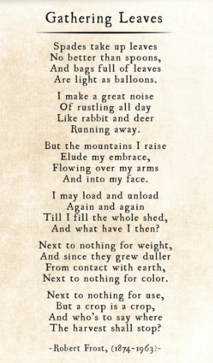
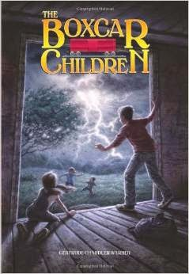
Context and Connotation Benchmark Progression 2nd - 3rd
Second | Third
Identify and use context clues, word relationships, reference materials, and/or background knowledge to determine the meaning of unknown words. | Use context clues, figurative language, word relationships, reference materials, and/or background knowledge to determine the meaning of multiple-meaning and unknown words and phrases, appropriate to grade level.
https://creativecommons.org/
Notes:
1 minute (39.5/50)
The second grade benchmark for context and connotation removes picture clues from the expectations, and focuses on context clues, word relationships, reference materials and/or background knowledge to determine the meaning of unknown words.
For this example, we are highlighting another poem from the B.E.S.T. Sample Text List; “Gathering Leaves,” by Robert Frost, as it is an exemplar text for covering many components of this benchmark.
As students move away from pictures/illustrations to accompany the text they encounter, they will need to rely more heavily on context clues.
Here is an instructional routine that will provide explicit instruction for this benchmark.
The teacher clearly identifies and uses the context clues, word relationships, reference materials and/or background knowledge to determine the meaning of an unknown word.
The teacher demonstrates/models how to identify and use the context clues, word relationships, reference materials and/or background knowledge to determine the meaning of an unknown word.
The teacher shows visual and auditory examples/non-examples.
The teacher provides opportunities for guided and independent practice.
The third grade benchmark for context and connotation incorporates using figurative language and the addition of determining the meaning of multiple-meaning phrases, appropriate to grade level.
The clarifications for this benchmark state that instruction for this benchmark should include text read-alouds and think-alouds aimed at building and activating background knowledge.
The Boxcar Children books provide a plethora of opportunities for explicit vocabulary instruction during a read-aloud. Plus, who doesn’t love the Boxcar Children?
Here is an instructional routine that will provide explicit instruction for this benchmark.
The teacher clearly identifies the context clues, figurative language, word relationships, reference materials and/or background knowledge to determine the meaning of an unknown word or phrase.
The teacher demonstrates/models how to identify the context clues, figurative language, word relationships, reference materials and/or background knowledge to determine the meaning of an unknown word or phrase.
The teacher shows visual and auditory examples/non-examples.
The teacher provides opportunities for guided and independent practice.

Slide 35
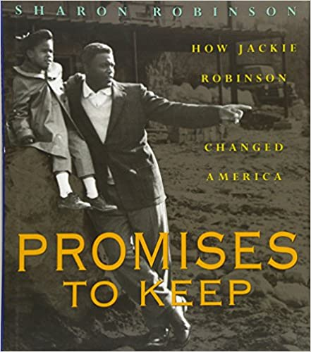
Context and Connotation Benchmark Progression 4th - 5th
Fourth | Fifth
Use context clues, figurative language, word relationships, reference materials, and/or background knowledge to determine the meaning of multiple-meaning and unknown words and phrases, appropriate to grade level.
https://creativecommons.org/
Notes:
1 minute (40.5/50)
The context and connotation benchmarks for fourth and fifth grade are identical and mirror the third grade benchmark.
The two texts chosen for these grade levels are on the B.E.S.T. sample text list and are already aligned to reading benchmarks, which will make the act of stacking benchmarks for instruction even easier!
The clarifications for this benchmark state that texts read aloud can be two grade levels higher than student reading level, so keep that in mind when planning for instruction.
Here is an instructional routine that will provide explicit instruction for this benchmark.
The teacher clearly identifies the context clues, figurative language, word relationships, reference materials and/or background knowledge to determine the meaning of an unknown word or phrase.
The teacher demonstrates/models how to identify the context clues, figurative language, word relationships, reference materials and/or background knowledge to determine the meaning of an unknown word or phrase.
The teacher shows visual and auditory examples/non-examples.
The teacher provides opportunities for guided and independent practice.

Slide 36
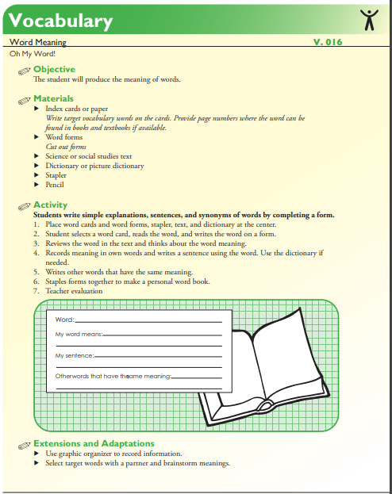
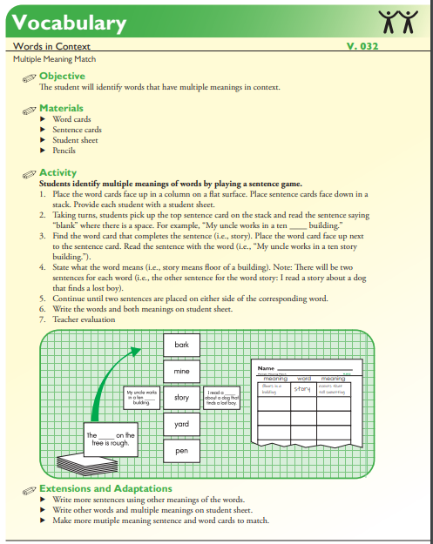
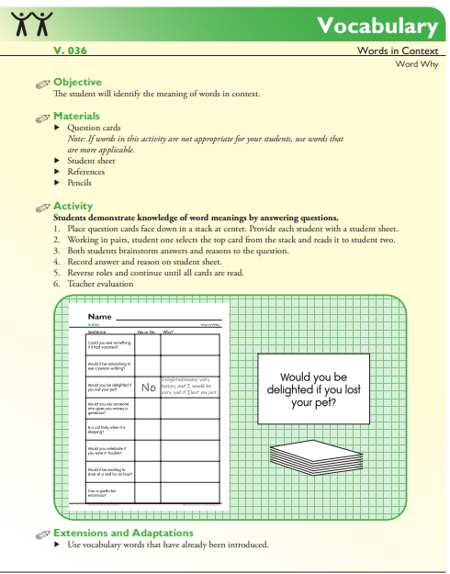
Context and Connotation
FCRR Student Center Activities
https://creativecommons.org/
Notes:
.5 minute (41/50)
FCRR provides many Student Center Activities that support this benchmark.

Slide 37
Explicit Vocabulary Development and Instruction: Session Reflection
COMPASS REFLECTION
NORTH
EAST
SOUTH
WEST
COMPASS REFLECTION
NORTH
EAST
SOUTH
WEST
N: What else do you NEED to know or find out about explicit vocabulary instruction aligned to the B.E.S.T. ELA Standards?
E: What EXCITES you about vocabulary instruction aligned to the B.E.S.T. ELA Standards?
S: What are your next STEPS?
W: What WORRIES you about potential vocabulary instruction roadblocks aligned to the B.E.S.T. ELA Standards?
Notes:
5 minutes (46/50)
Handout #1 Note Catcher
As we wrap up our professional learning session on Explicit Vocabulary Development and Instruction for B.E.S.T., we want to take a few minutes to reflect on the information shared today and jot down notes using the Compass Reflection in Handout #1 Note Catcher.
Read slide and give directions.
We wish you the best of luck as you move forward with implementing the B.E.S.T. Vocabulary Standards with students!

Slide 38
Works Cited
http://dyslexiahelp.umich.edu/professionals/dyslexia-school/vocabulary
http://handyhandouts.com/viewHandout.aspx?hh_number=182&nfp_title=Three+Tiers+of+Vocabulary+and+Education
https://www.fldoe.org/core/fileparse.php/7539/urlt/elabeststandardsfinal.pdf
https://www.readingrockets.org/teaching/reading-basics/vocabulary
https://www.shanahanonliteracy.com/blog/five-things-every-teacher-should-know-about-vocabulary-instruction#sthash.JNXrLye7.dpbs
https://www.wvced.com/wp-content/uploads/2019/04/Morphology-Matters-4-1-19.pdf
https://creativecommons.org/
Notes:
.5 minute (46.5/50)
These resources were used in developing the content for this presentation.

Slide 39
Natalie Montgomery
Natalie.Montgomery@fldoe.org
Reading Specialist, Just Read, Florida!
Randi Shiver
Randi.Shiver@fldoe.org
Reading Specialist, Just Read, Florida!
Notes:
3.5 minutes (50/50)
Provide time for questions.
We can be reached by email if any questions arise.

